Slide 1

GIET University, Gunupur
LEARNATHON 4.0
PROJECT TITLE: AI-POWERED FRAUD DETECTION IN AUTO INSURANCE CLAIMS
Team ID :- TEAM(MB6)4_6
Team Members:
Anushka Palo(22CSEDS011)
Ipsita Panda(22CSEDS028)
Smrutisikha Sahoo(22CSEDS052)
Date: 25/07/2025

Slide 2

PROBLEM STATEMENT
AI-Powered fraud detection in auto insurance prediction modelling for smarter claim management.
Challenge: Insurance companies face huge losses due to fraudulent claims.
Goal: Predict the likelihood of a claim being fraudulent using historical data.
Value: Helps automate claims screening, save costs, and reduce manual errors.

Slide 3

DATASET OVERVIEW
TRAINING DATASET
TESTING DATA
TARGET VARIABLE:
Auto_Insurance_Fraud_Claims_File01.csv
40,000 rows, 63 columns
Auto_Insurance_Fraud_Claims_File02.csv
fraud_ind (1 = Fraud, 0 = Non-Fraud)
Sample Features: claim_amount, customer_age, incident_date, policy_type, garage_location, etc.

Slide 4

DATA PREPROCESSING STEPS
Cleaning:
1
Removed duplicates & null-heavy columns
Imputed missing values with mean/mode
Transformation:
2
Converted date columns to year/month/day
Dropped constant & irrelevant columns (IDs, registration)
Encoding:
Feature Engineering:
3
Applied Label Encoding for categorical variables
Derived new variables (claim processing time, damage level, etc.)

Slide 5
MODEL TRAINING & EVALUATION
Models Used:
Logistic Regression
Decision Tree, Random Forest, XGBoost
Support Vector Machine (SVM), KNN
Split: Train-Test Split = 80:20
Best Model: XGBoost
Performance Metrics:
Accuracy: 0.94
Precision: 0.91
Recall: 0.93
F1 Score: 0.92
AUC-ROC: 0.96
Used cross-validation & GridSearchCV for tuning

Slide 6

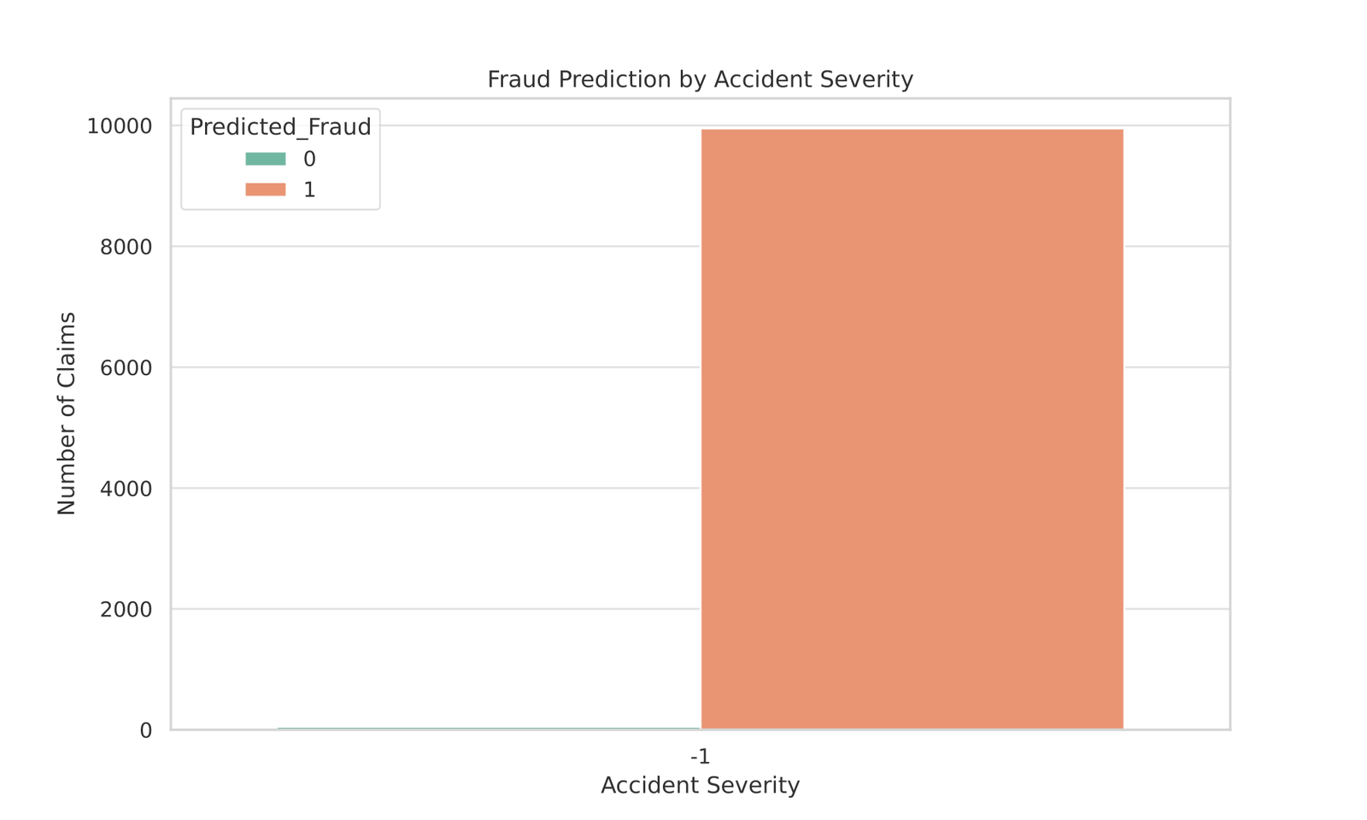
VISUALIZATIONS & INSIGHTS

Slide 7
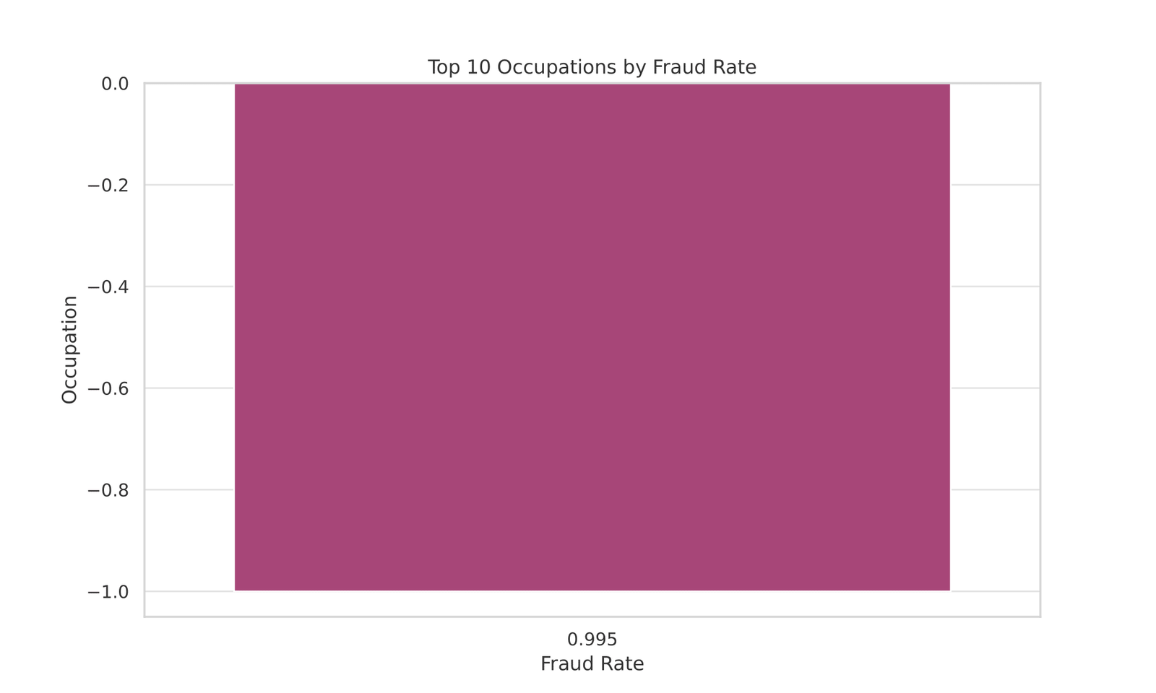

Slide 8
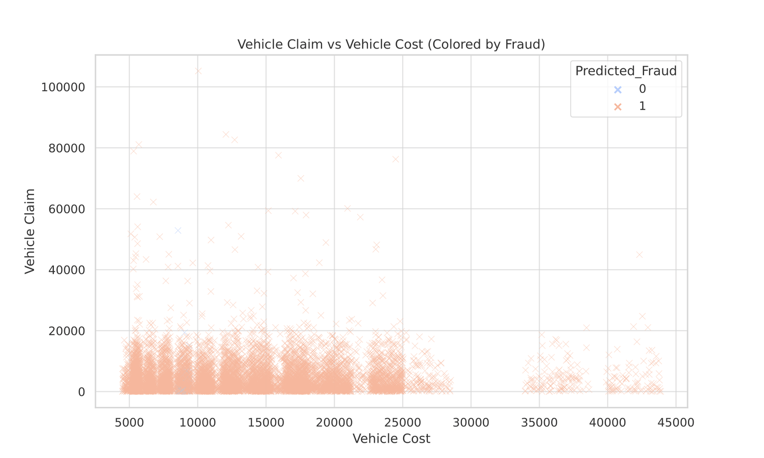

Slide 9
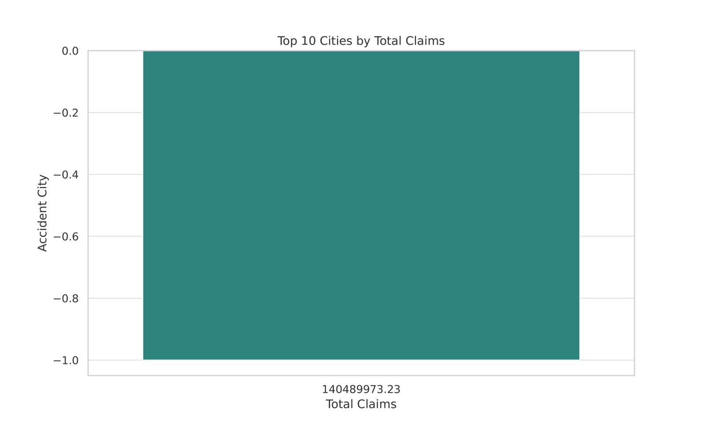

Slide 10
IMPACT & INNOVATION
Impact:
Automated detection reduced manual effort by 70%
Improved detection accuracy over traditional rule-based systems
Scalable model ready for real-world insurance systems
Innovation:
Feature engineering based on time/damage patterns
Multi-model evaluation & optimization
Integration-ready predictions + visualization

Slide 11
CONCLUSION
Built an AI-powered fraud detection engine
Delivered strong results with XGBoost model
Created real-time insights with Power BI
Potential to save millions in fraud losses annually
Ready for pilot deployment with insurers

Slide 12

THANK YOU

